Slide 1
Digital Image Processing
Lecture 09: Image Restoration-I

Slide 2
Image Restoration
In many applications (e.g., satellite imaging, medical imaging, astronomical imaging, poor-quality family portraits) the imaging system introduces a slight distortion
Image Restoration attempts to reconstruct or recover an image that has been degraded by using a priori knowledge of the degradation phenomenon.
Restoration techniques try to model the degradation and then apply the inverse process in order to recover the original image.

Slide 3
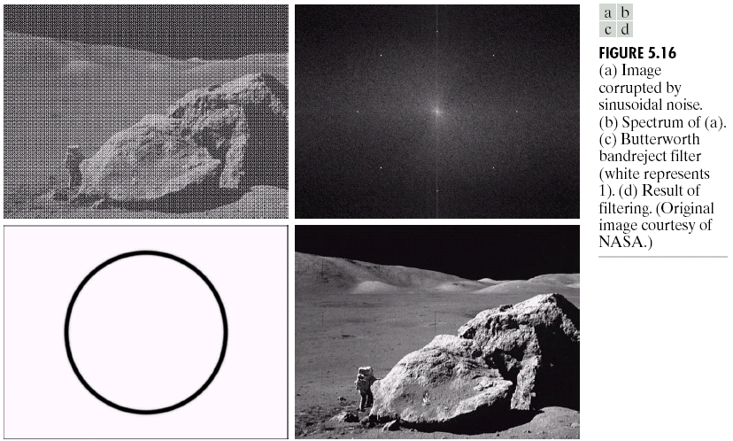
Image Restoration
Image restoration attempts to restore images that have been degraded
  Identify the degradation process and attempt to reverse it
  Similar to image enhancement, but more objective

Slide 4
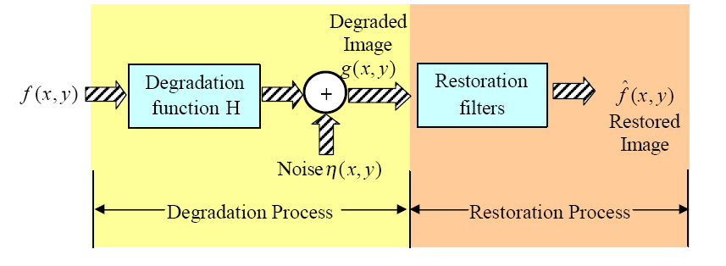
A Model of the Image Degradation/ Restoration Process

Slide 5
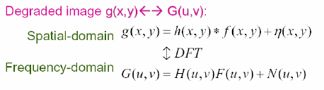
A Model of the Image Degradation/ Restoration Process
The degradation process can be modeled as a degradation function H that, together with an additive noise term η(x,y) operates on an input image f(x,y) to produce a degraded image g(x,y)

Slide 6

A Model of the Image Degradation/ Restoration Process
Since the degradation due to a linear, space-invariant degradation function H can be modeled as convolution, therefore, the degradation process is sometimes referred to as convolving the image with as PSF or OTF.
Similarly, the restoration process is sometimes referred to as deconvolution.

Slide 7
Image Restoration
If we are provided with the following information
  The degraded image g(x,y)
  Some knowledge about the degradation function H , and
  Some knowledge about the additive noise η(x,y)
Then the objective of restoration is to obtain an estimate f^{ˆ}(x,y) of the original image

Slide 8
Principle Sources of Noise
Image Acquisition
  Image sensors may be affected by Environmental conditions (light levels etc)
  Quality of Sensing Elements (can be affected by e.g. temperature)
Image Transmission
  Interference in the channel during transmission e.g. lightening and atmospheric disturbances

Slide 9
Noise Model Assumptions
Independent of Spatial Coordinates
Uncorrelated with the image i.e. no correlation between Pixel Values and the Noise Component

Slide 10
White Noise
When the Fourier Spectrum of noise is constant the noise is called White Noise
The terminology comes from the fact that the white light contains nearly all frequencies in the visible spectrum in equal proportions
The Fourier Spectrum of a function containing all frequencies in equal proportions is a constant

Slide 11
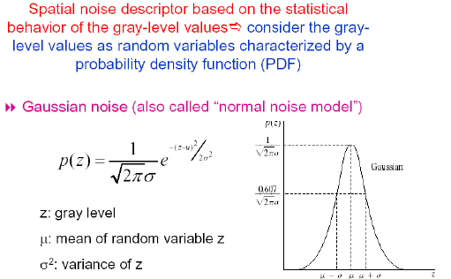
Noise Models: Gaussian Noise

Slide 12
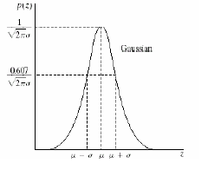
Noise Models: Gaussian Noise
Approximately 70% of its value will be in the range [(µ-σ), (µ+σ)] and about 95% within range [(µ-2σ), (µ+2σ)]
Gaussian Noise is used as approximation in cases such as Imaging Sensors operating at low light levels

Slide 13
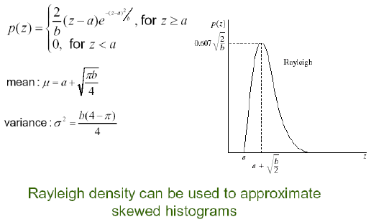
Noise Models: Rayleigh Noise
Rayleigh Noise arises in Range Imaging

Slide 14
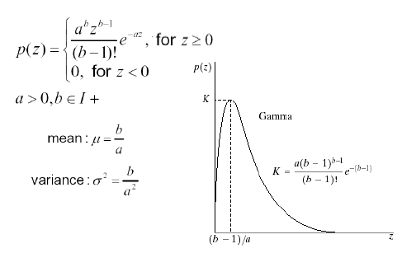
Noise Models: Erlang (Gamma) Noise
Rayleigh Noise arises in Laser Imaging

Slide 15
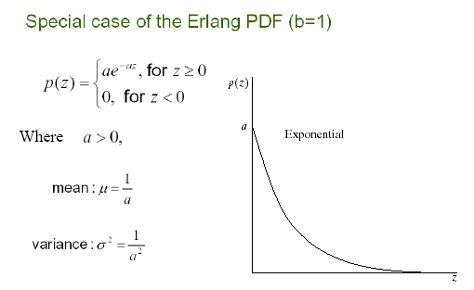
Noise Models: Exponential Noise

Slide 16
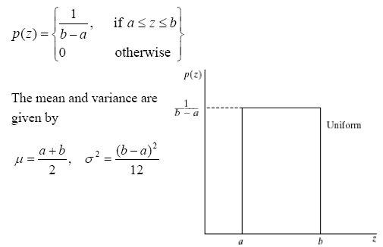
Noise Models: Uniform Noise

Slide 17
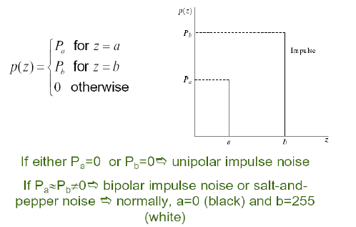
Noise Models: Impulse (Salt and Pepper) Noise

Slide 18
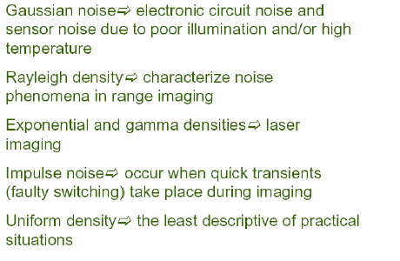
Applicability of Various Noise Models

Slide 19
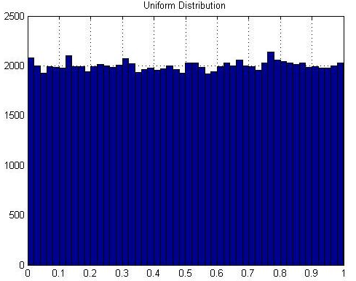
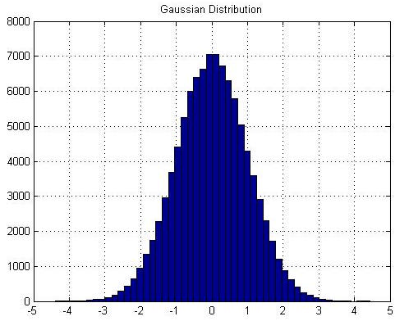
Noise Models

Slide 20
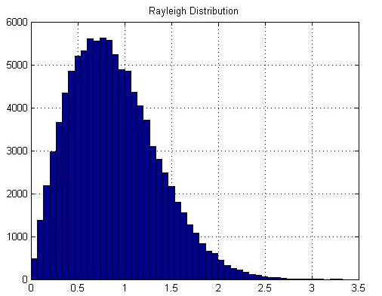
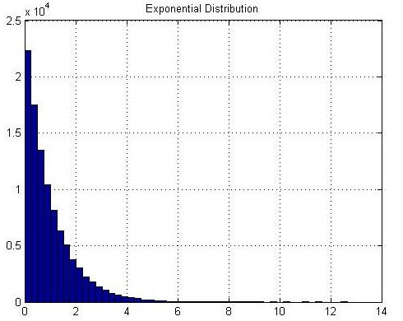
Noise Models

Slide 21
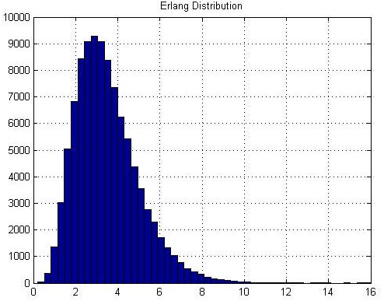
Noise Models

Slide 22
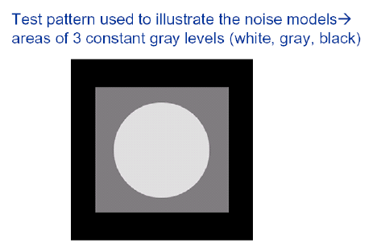
Noise Patterns (Example)

Slide 23
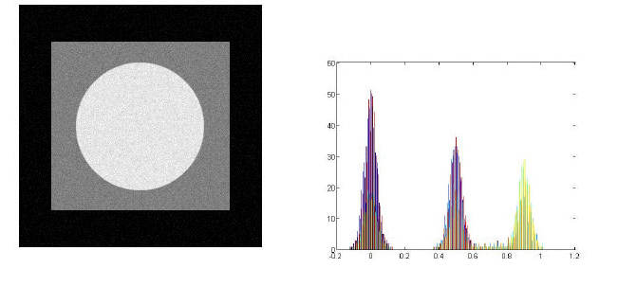
Image Corrupted by Gaussian Noise

Slide 24
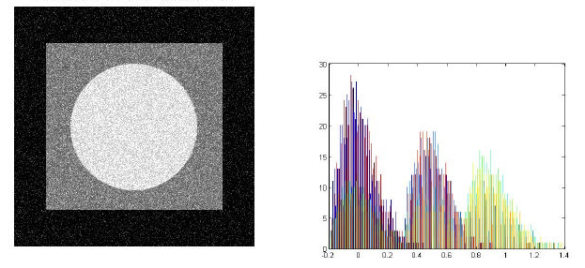
Image Corrupted by Rayleigh Noise

Slide 25
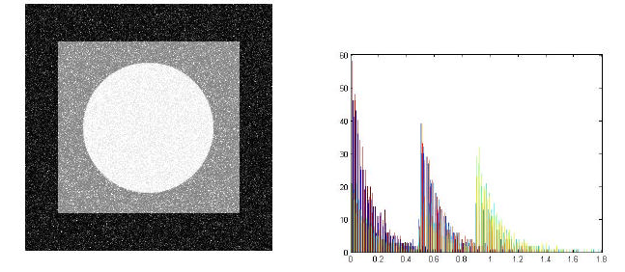
Image Corrupted by Gamma Noise

Slide 26
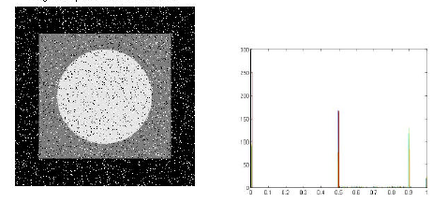
Image Corrupted by Salt & Pepper Noise

Slide 27
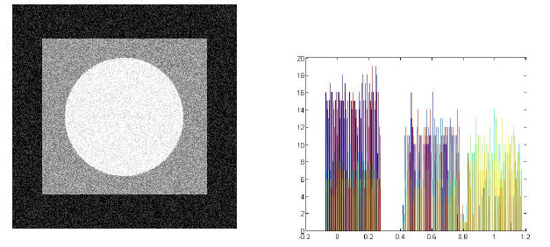
Image Corrupted by Uniform Noise

Slide 28
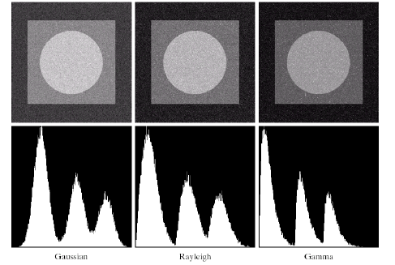
Noise Patterns (Example)

Slide 29
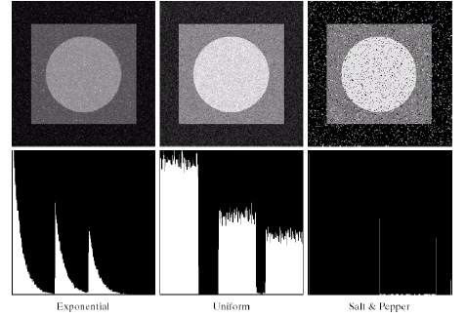
Noise Patterns (Example)

Slide 30
Periodic Noise
Arises typically from Electrical or Electromechanical interference during Image Acquisition
Nature of noise is Spatially Dependent
Can be removed significantly in Frequency Domain

Slide 31
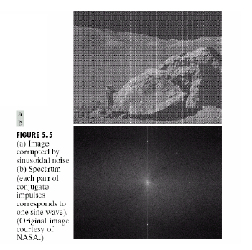
Periodic Noise (Example)

Slide 32
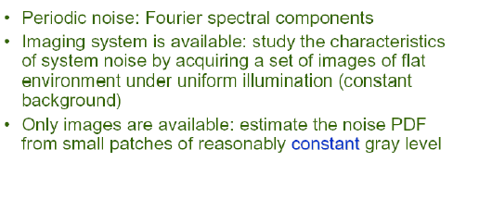
Estimation of Noise Parameters

Slide 33
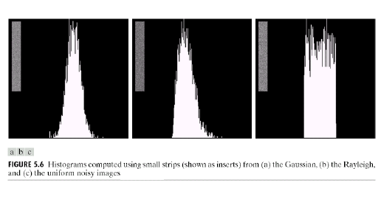
Estimation of Noise Parameters (Example)

Slide 34
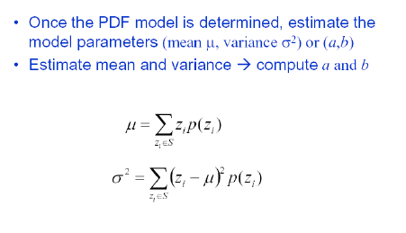
Estimation of Noise Parameters

Slide 35
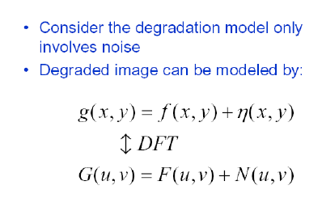
Restoration of Noise-Only Degradation

Slide 36
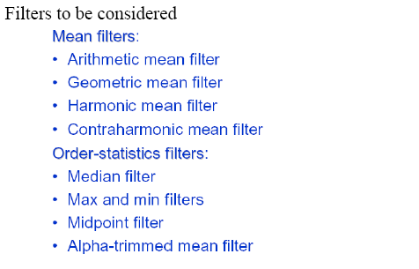
Restoration of Noise Only- Spatial Filtering

Slide 37
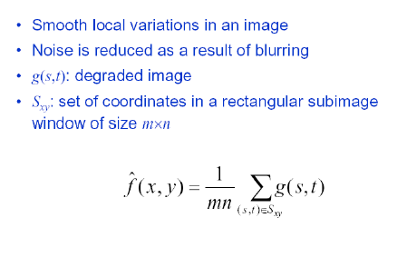
Arithmetic Mean Filter

Slide 38
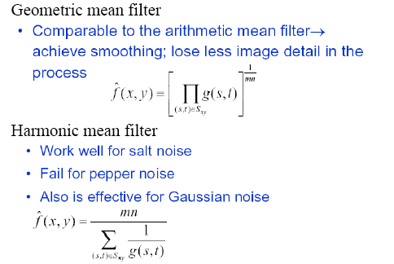
Geometric and Harmonic Mean Filter

Slide 39
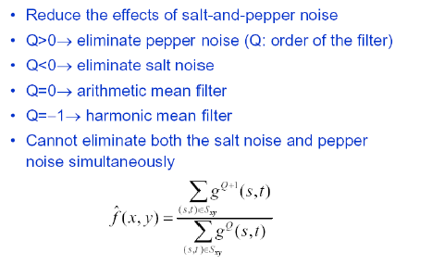
Contra-Harmonic Mean Filter

Slide 40
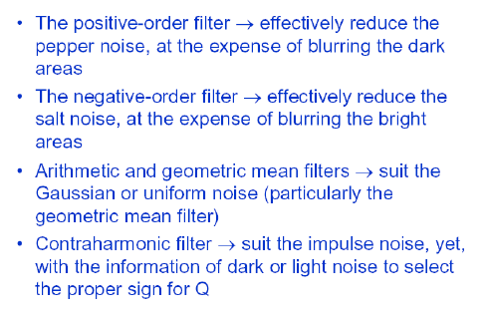
Classification of Contra-Harmonic Filter Applications

Slide 41
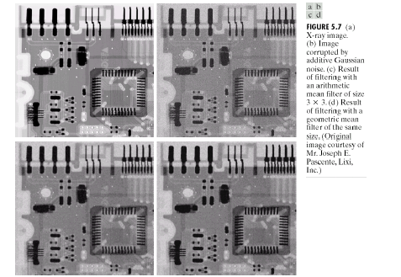
Arithmetic and Geometric Mean Filters (Example)

Slide 42
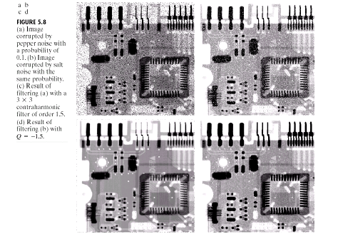
Contra-Harmonic Mean Filter (Example)

Slide 43
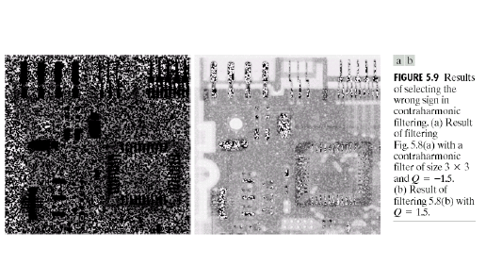
Contra-Harmonic Mean Filter (Example)

Slide 44
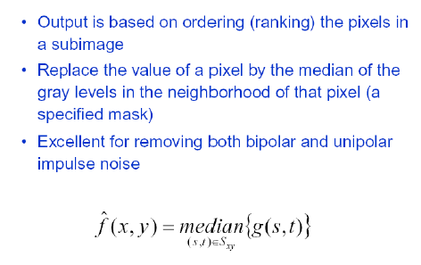
Order Statistics Filters: Median Filter

Slide 45
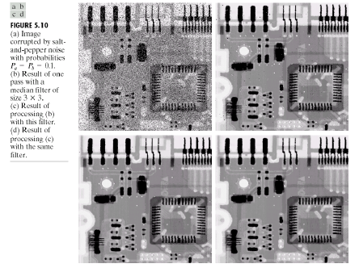
Median Filter (Example)

Slide 46
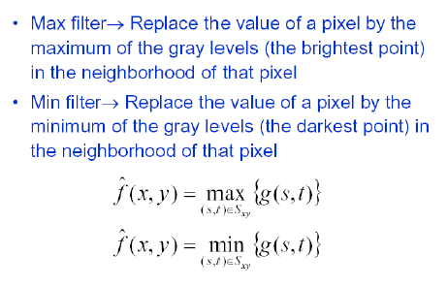
Order Statistics Filters: Max and Min filter

Slide 47
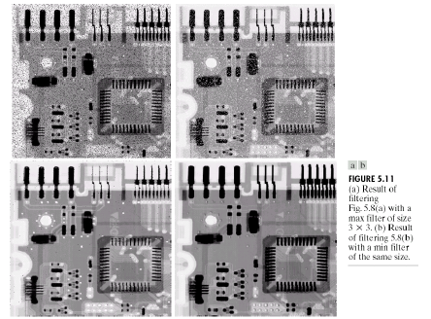
Max and Min Filters (Example)

Slide 48
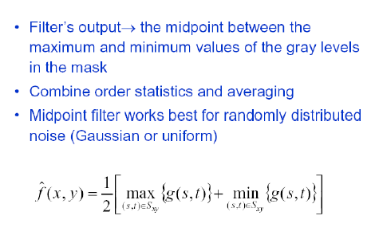
Order Statistics Filters: Midpoint Filter

Slide 49
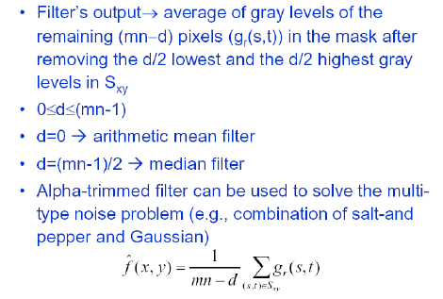
Order Statistics Filters: Alpha-Trimmed Mean Filter

Slide 50
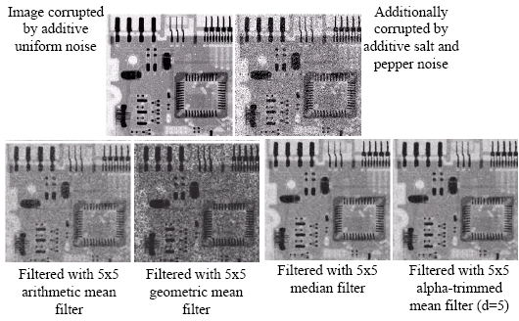
Examples

